Slide 1
Problem Identification
How can Big Mountain Resort capitalize on their facilities to select a data-driven value for their ticket price, and what changes can they implement that allow for higher ticket prices or cut costs without sacrificing the visitor experience?

Slide 2
Recommendation and Key Findings
Increase adult ticket price to $97.86.
Add a new run.
Increase vertical drop by 150 feet.
Install an additional chair lift.
Close the least used run.
Gather data on operating costs and visitor numbers for Big Mountain Resorts and the other resorts in our study, so that we can make additional recommendations.

Slide 3
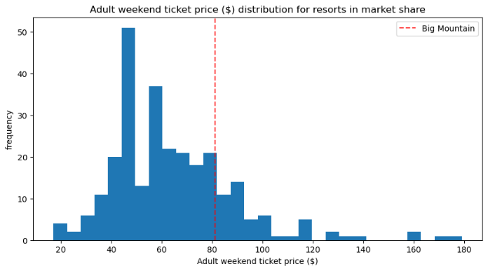
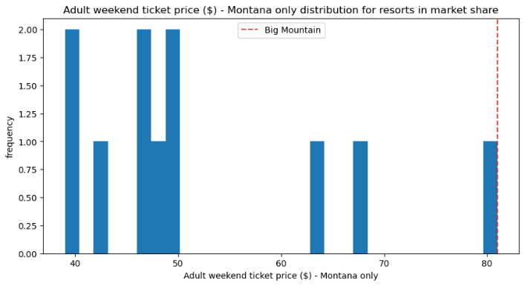
Modeling Results & Analysis
Current Pricing
These histograms show where Big Mountain Resort’s current pricing is compared to other resorts, both in the national market share and in Montana. It is important to note that Big Mountain Resort has more facilities than the other resorts in Montana.
As you will see in the following 2 slides, Big Mountain Resort ranks well above the average for all of the following facilities which positively impact ticket pricing.

Slide 4
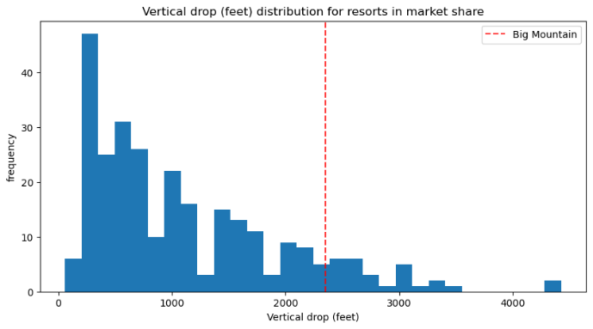
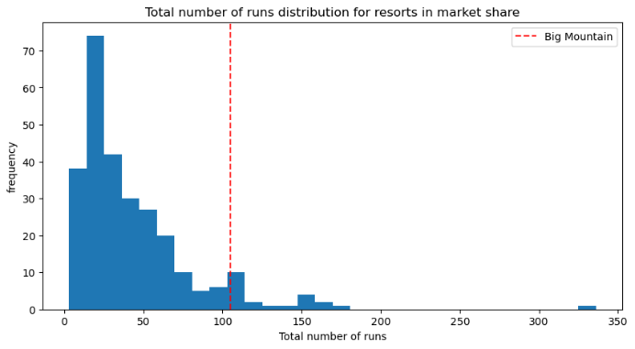
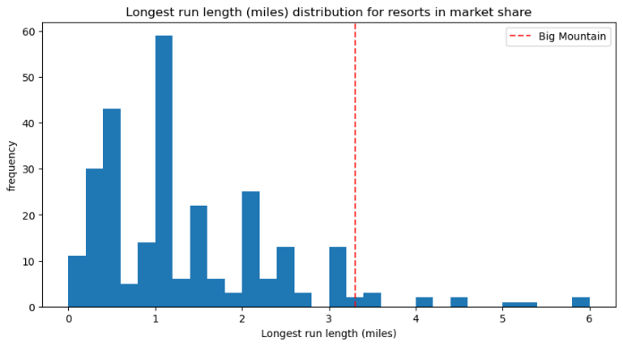
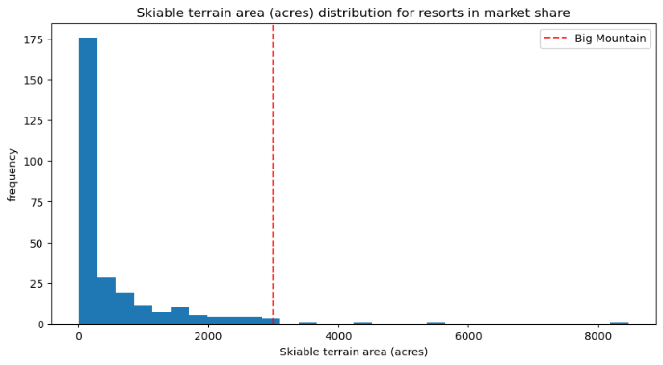
Modeling Results & Analysis
Distribution of facilities for resorts in market share

Slide 5
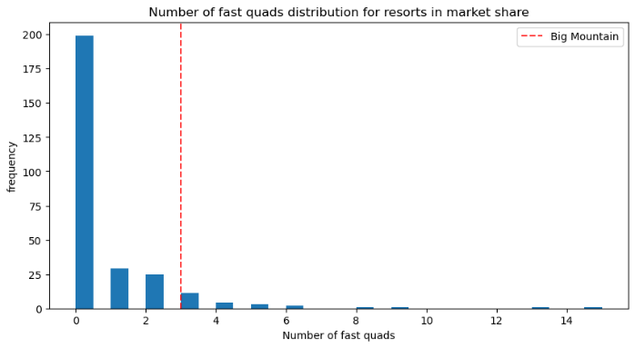
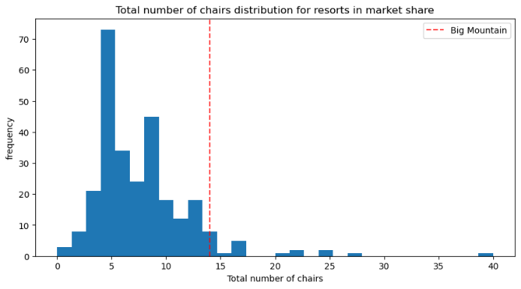
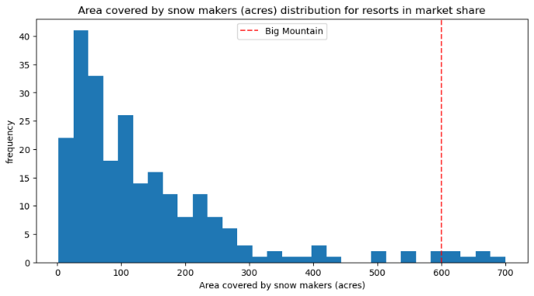
Modeling Results & Analysis
Distribution of facilities for resorts in market share

Slide 6
Summary and Conclusion
Big Mountain Resort’s current facilities can support a price of $95.87, but adding an additional chair lift, run and increasing the vertical drop by 150 feet supports a total price of $97.86. There is a leeway of about $10 in either direction.
Closing the 5 least popular runs may also help reduce operating costs, but further study is needed before officially recommending this option.

